Slide 1

MMM Case Study: Driving Growth Through Smarter Media Investment
Prepared by : Akhand Pratap Singh

Slide 2



Key Insights: Decoding Media Performance
This OLS Marketing Mix Modeling (MMM) analysis provides a data-driven understanding of media channel effectiveness and offers actionable insights for optimizing future campaigns.
Model Robustness
High ROI Channels
This model achieved an R² of 0.79 and an Adjusted R² of 0.72, explaining approximately 72% of the variance in our key performance indicator.
WhatsApp, Hotstar, and Ventes Avenue emerged as top performers, delivering strong returns on investment.
Underperforming Channels
Multicollinearity Noted
Conversely, YouTube, Jio, and Google Display exhibited negative or low ROI, indicating areas for re-evaluation.
A high VIF (Variance Inflation Factor) for the constant suggests potential multicollinearity, which requires careful consideration in interpreting coefficients.

Slide 3
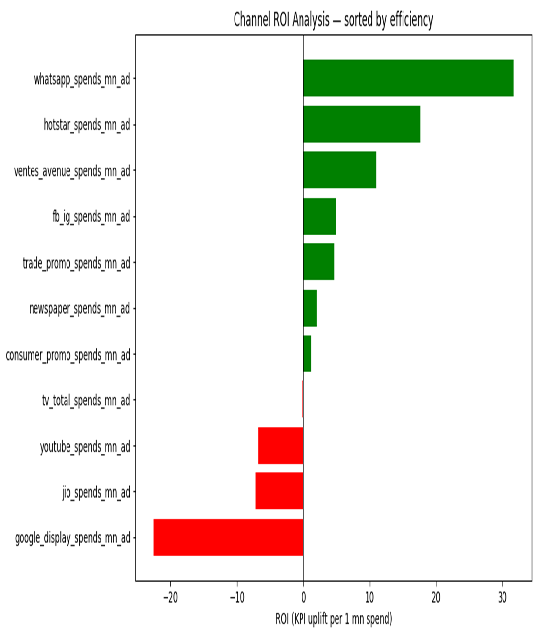
Channel Performance: ROI Breakdown
Understanding the Return on Investment (ROI) for each marketing channel is crucial for effective budget allocation. This visualization clearly highlights which channels are driving the most value.
The chart illustrates the calculated ROI values, emphasizing the need to shift investment towards the more profitable platforms.

Slide 4
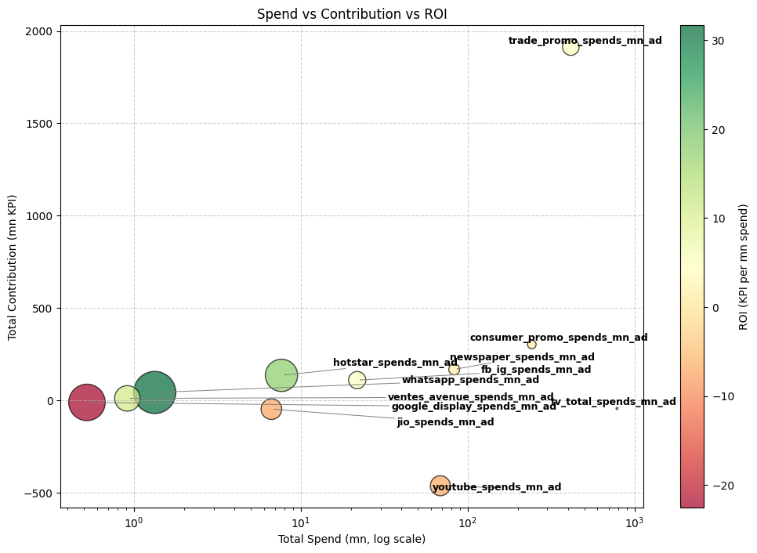
Strategic Allocation: Spend vs. Contribution
This bubble chart visualizes the interplay between marketing spend and a channel's contribution to overall performance. The size of the bubble indicates its ROI, providing a holistic view for decision-making.
Channels positioned higher on the Y-axis and further right on the X-axis, with larger bubbles, represent optimal investment
opportunities.
X-axis (Spend): how much you invested in each channel.
Y-axis (Contribution): how much KPI that channel is estimated to have driven
Contribution of Channel i =∑(Predicted KPI with all channels−Predicted KPI with channel i turned off)
Bubble size: ROI (KPI per 1 Mn spend).
Bubble color: positive ROI (green) vs negative ROI (red).

Slide 5
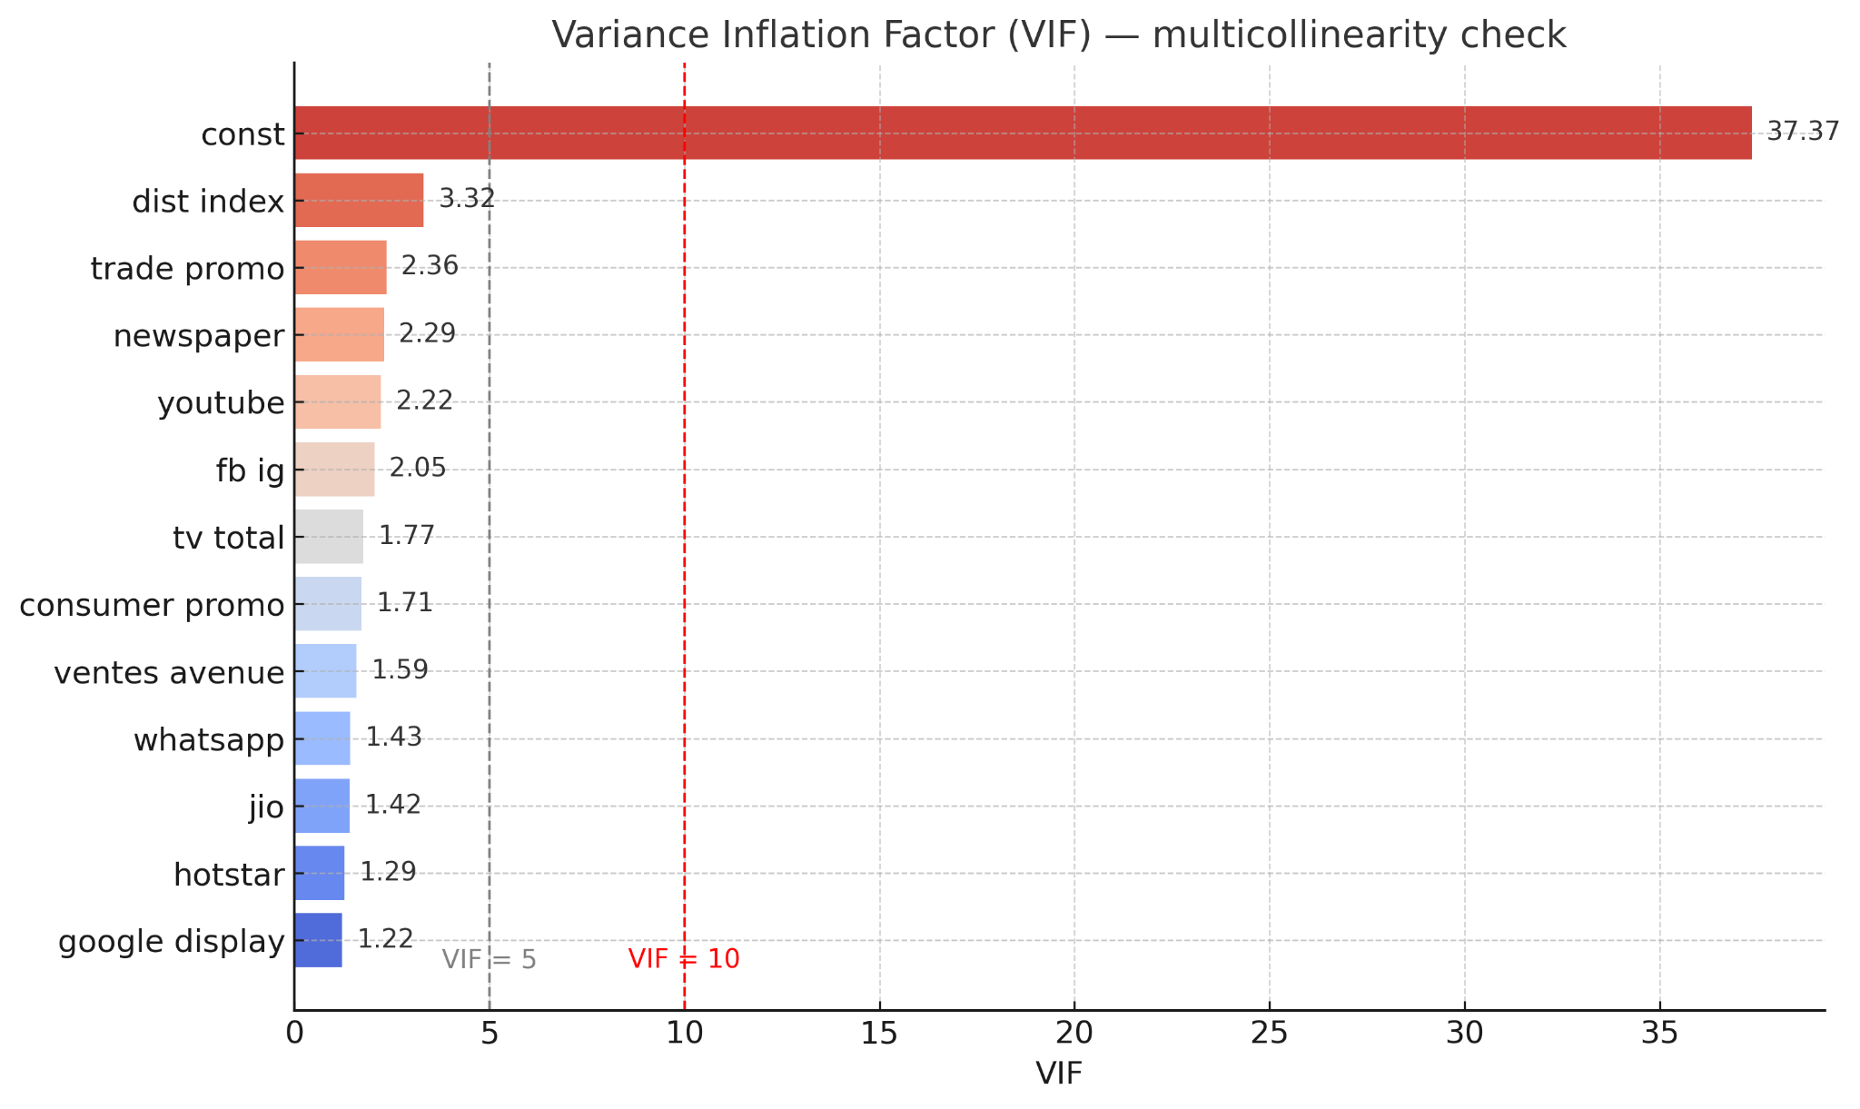
Model Diagnostics: Collinearity Assessment
Collinearity refers to a high correlation between predictor variables in a regression model. The Variance Inflation Factor (VIF) helps detect the severity of multicollinearity.
High VIF values, particularly for the constant, indicate that certain variables might be too strongly related, potentially impacting the reliability of individual coefficient estimates.

Slide 6

Optimizing Spend: Budget Allocation Recommendations
Based on the ROI analysis, we propose a strategic shift in media budget to maximize overall marketing effectiveness and achieve higher KPI uplift.
Reduce Investment in Low-ROI Channels
Strategically decrease budget allocation to channels like YouTube, Jio, and Google Display that show negative or marginal returns.
Reinvest in High-ROI Performers
Reallocate freed-up funds to high-performing channels such as WhatsApp, Hotstar, and Ventes Avenue to amplify their impact.
Fine-Tune Adstock & Saturation
Before significant reallocations, further analyze and adjust adstock and saturation effects to ensure the model accurately captures true channel diminishing returns.
Incremental Budget Shifts
Adopt a conservative approach with 5-10% budget shifts initially, allowing for continuous validation and iterative optimization rather than drastic changes.

Slide 7
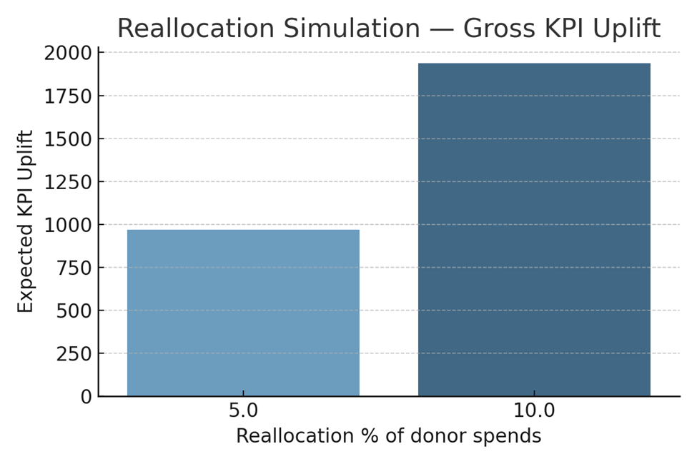
Projected Impact: Reallocation Simulation Results
My simulations demonstrate the tangible uplift in Key Performance Indicators (KPIs) achievable through the recommended budget reallocations.
5% Reallocation
Projects a potential ~968 KPI uplift (conservative estimate: 484), demonstrating immediate positive impact from modest adjustments.
10% Reallocation
Indicates an estimated ~1936 KPI uplift (conservative estimate: 968), highlighting the significant potential for growth with strategic shifts.
These projections provide a strong case for implementing the recommended changes, with a focus on validating actual performance incrementally.

Slide 8
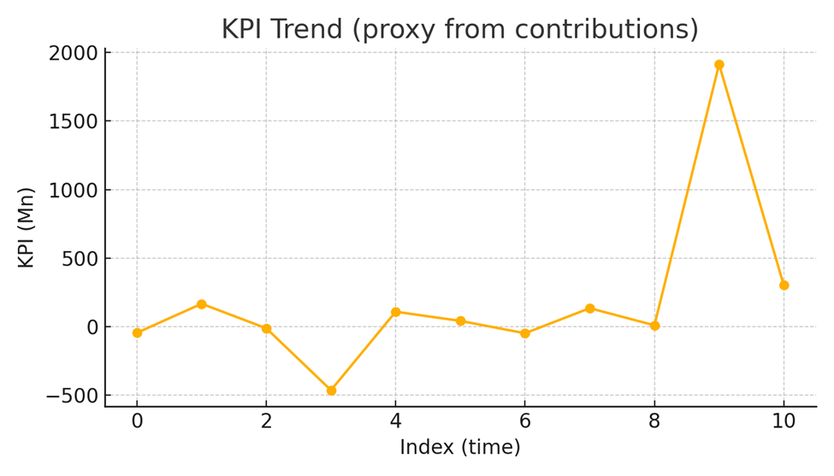
Market Pulse: KPI Trend Over Time
Tracking the Key Performance Indicator (KPI) trend over time provides critical context for understanding overall business trajectory and the impact of marketing efforts.
This line chart illustrates the fluctuations and overall direction of the KPI, allowing us to correlate performance with specific marketing campaigns or market events.

Slide 9
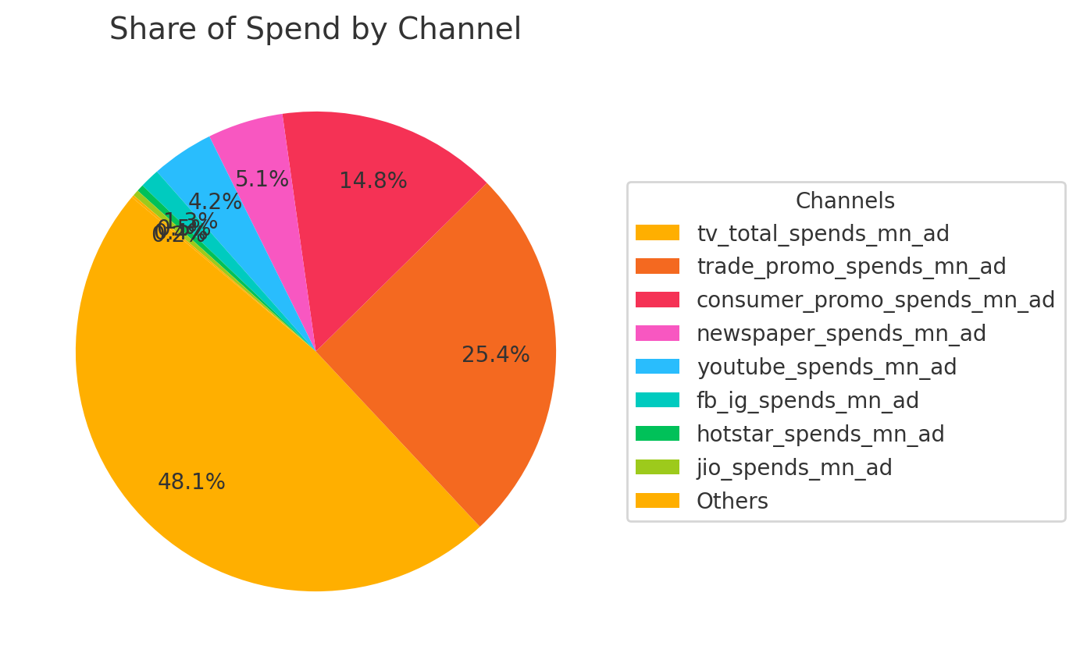
Budget Landscape: Share of Spend by Channel
This pie chart presents the current distribution of marketing spend across various channels, offering a clear picture of our current investment priorities.
Comparing this spend distribution with the ROI analysis (Card 3) will highlight opportunities for re-prioritization and more efficient resource allocation to optimize marketing outcomes.

Slide 10
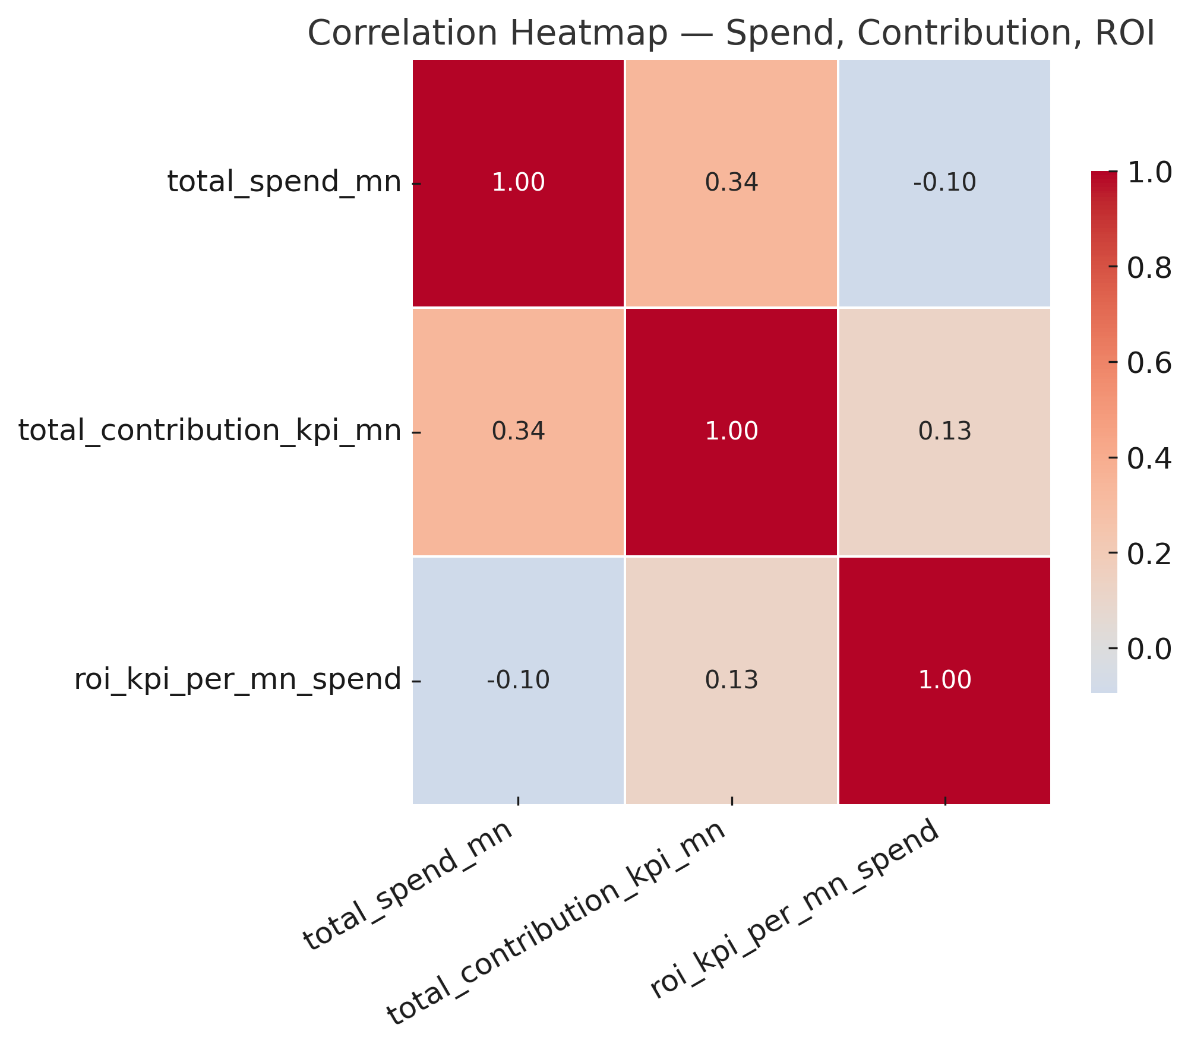
Correlation Matrix : Spend
Contribution and ROI
Total spend vs Contribution:
Moderate positive correlation (+0.34) → spending more generally increases contribution, but not very strongly.
Total spend vs ROI:
Slight negative correlation (−0.10) → higher spends do not always lead to higher ROI, suggesting inefficiencies at scale
Contribution vs ROI:
Weak positive correlation (+0.13) → channels that contribute more sometimes also yield higher ROI, but the effect is weak

Slide 11
Modeling Approaches
In this Marketing Mix Modeling (MMM) analysis, I applied two complementary regression approaches:
1- OLS (Ordinary Least Squares): explained ~72% variance (Adj. R² = 0.72)
i) Some channels showed unstable ROI estimates
ii) High VIF (multicollinearity risk, especially constant term)
2- Ridge regression (CV-tuned α ≈ 0.18) provided
i) More stable coefficients
ii) Reduced variance inflation
iii) Different ROI patterns for some channels (e.g., Google Display, YouTube penalized)
iv) Ridge helps mitigate multicollinearity issues flagged in OLS (high VIF)
v) Provided smoother, more stable coefficients vs OLS
vi) Google Display & YouTube ROI reduced (likely overestimated in OLS)
vii) WhatsApp, Hotstar, Ventes Avenue remain top-performing

Slide 12
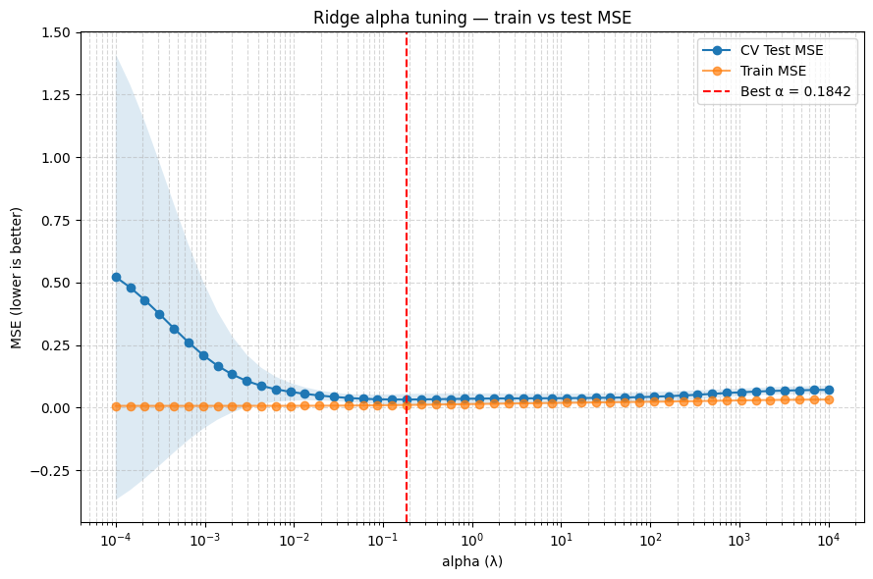
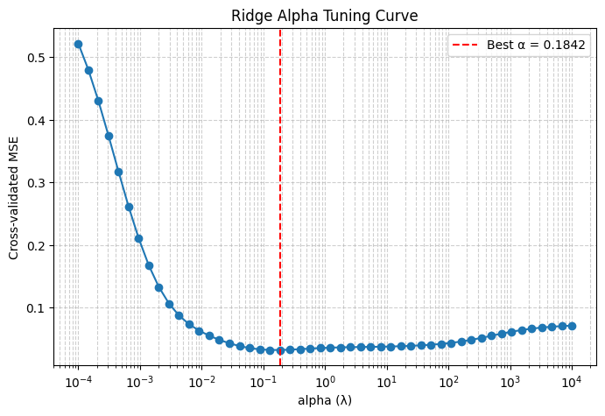
Modeling Approaches
Ridge regression (CV-tuned α ≈ 0.18) provided

Slide 13
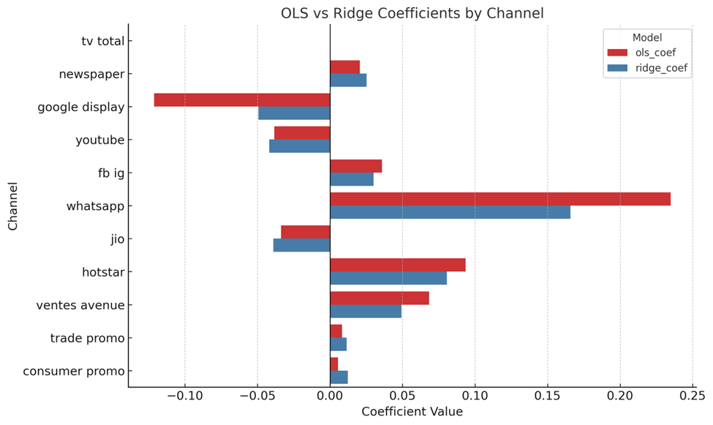
Optimizing Spend: Budget Allocation Recommendations
i) Ridge shrinks extreme OLS coefficients, reducing noise in unstable channels
ii) High ROI channels (WhatsApp, Hotstar, Ventes Avenue) remain strong across both models
iii) Ridge provides more conservative, reliable estimates for budget planning
iv) If Use OLS + Ridge together → if both agree, confidence is high; if not, validate with experiments

Slide 14
OLS Model Validation: Assessing Reliability
Thorough model diagnostics ensure the reliability and generalizability of our Marketing Mix Model, allowing for confident decision-making.
Performance Metrics
Test Data Overfit Risk
Suspicious ROI
The model shows strong fit on training data (Train R² = 0.756, RMSE = 0.110).
An exceptional Test R² = -8.432 and RMSE = 0.070 suggest potential overfitting due to a very small test sample, warranting caution.
The negative ROI for Google Display (-55) requires further investigation to understand underlying factors.
Coefficient Stability
Future Validation
Rolling coefficient stability checks revealed some variability, emphasizing the need for ongoing monitoring.
I recommend validating stability with a longer historical horizon or through rigorous cross-validation techniques.

Slide 15

“Smarter allocation today drives measurable growth tomorrow.”
Thank You!

